Slide 1


Out of Control Rescuing a Failing Project
@housecor | reactjsconsulting.com

Slide 2
Problems
“We’ve spent millions on development. It’s not demoable.”
“It crashes too much to show stakeholders.”
“Nothing is done. Everything is partially complete.”
“We can’t seem to ship a stable release”.
“It takes us weeks to fix prod bugs”.

Slide 3
Two Apps, Same Stack
LTL shipping app React UI, .NET backend
Commercial electrician app React UI, .NET backend

Slide 4
The Beginning
🚩 No Tests
🚩 No linting
🚩 Too many environments and repos
🚩 No auto-formatting
🚩 1,300 ‘any’
🚩 No reusable components
🚩 Complex, redundant data fetching with no caching
🚩 No response validation
🚩 No error handling
🚩 Extremely unstable

Slide 5

15 Principles for Salvation

Slide 6


Principle 1
If it’s worth checking, it’s worth automating.
Problem: Code is inconsistently formatted.
Solution: Automate formatting.

Slide 7



Principle 1
If it’s worth checking, it’s worth automating.
Problem: Standards aren’t enforced.
Solution: Lint with max-warnings=0.

Slide 8
Principle 1
eslint-plugin-import
eslint-plugin-unicorn
eslint-plugin-cypress
eslint-plugin-playwright
prettier-plugin-packagejson
eslint-plugin-deprecation
eslint-plugin-import
eslint-plugin-jest
eslint-plugin-jsx-a11y
eslint-plugin-no-only-tests
eslint-plugin-stylelint
eslint-plugin-tailwindcss
eslint-plugin-query
eslint-plugin-prettier
eslint-plugin-testing-library
eslint-plugin-typescript-sort-keys
eslint-plugin-vitest-globals
eslint-config-eslint
eslint-plugin-jsdoc
eslint-plugin-node
eslint-plugin-storybook
eslint-plugin-promise
eslint-plugin-sonarjs
eslint-plugin-jsdoc
If it’s worth checking, it’s worth automating.
Problem: Code standards aren’t enforced
Solution: Use a linter.

Slide 9
Principle 1
If it’s worth checking, it’s worth automating.
Problem: We want to forbid a library.
Solution: Use no-restricted-imports.

Slide 10
Principle 1
If it’s worth checking, it’s worth automating.
Problem: We want to catch .only tests
Solution: Use eslint-plugin-no-only-tests.

Slide 11
Principle 1
If it’s worth checking, it’s worth automating.
Problem: We want to catch tests with no assert.
Solution: Use Jest, Cypress, or Playwright plugins.

Slide 12


Principle 1
If it’s worth checking, it’s worth automating.
Problem: Accessibility is important.
(Partial) Solution: Automate checks.

Slide 13

Principle 1
If it’s worth checking, it’s worth automating.
Problem: Unused code and types.
Solution: Knip

Slide 14
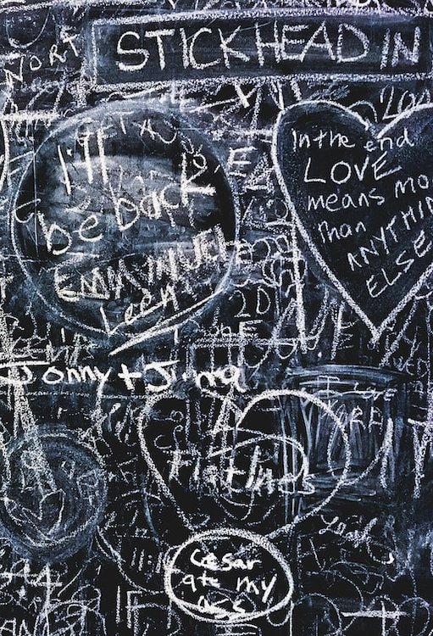

Principle 1
If it’s worth checking, it’s worth automating.
Problem: Spelling issues.
Solution: Run a spell checker.

Slide 15

Principle 1
If it’s worth checking, it’s worth automating.
Problem: Does it do what we expect?
Solution:
Automate tests.
Start with an E2E for each page.
Unit test pure functions.
Integration test complex flows.

Slide 16

Principle 1
If it’s worth checking, it’s worth automating.
Problem: How do we know all this works?
Solution: Check via CI.

Slide 17
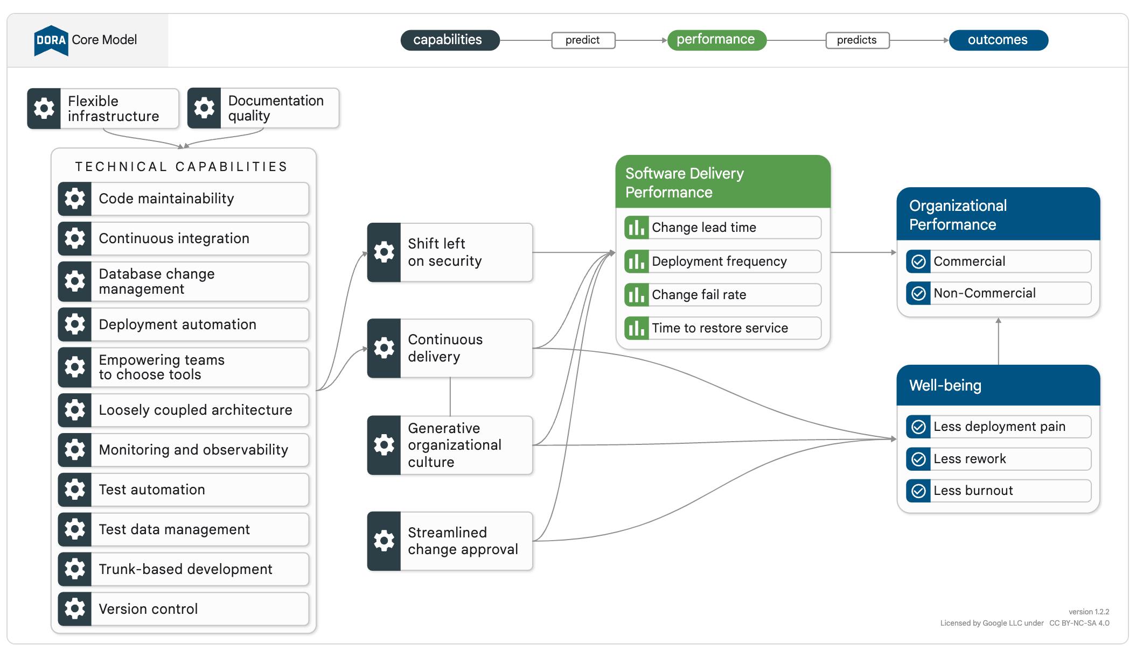
DevOps Research and Assessment (DORA)
dora.dev/research
Notes:
https://dora.dev/research/

Slide 18


Principle 2
Can’t be automated? Use a checklist.
Secure
Tested
Usable
Accessible
Performant
Robust (error handling)
Reusable
Readable (naming, organization)
Notes:
PULL_REQUEST_TEMPLATE.md

Slide 19
Principle 2
Can’t be automated? Use a checklist.
No commented out code
Approved by product owner
Notes:
PULL_REQUEST_TEMPLATE.md

Slide 20

Principle 3
If it’s decided, document it.
Colocate docs with code.
Consider README.md.
Create architectural decision records.
Focus code comments on *why*.

Slide 21
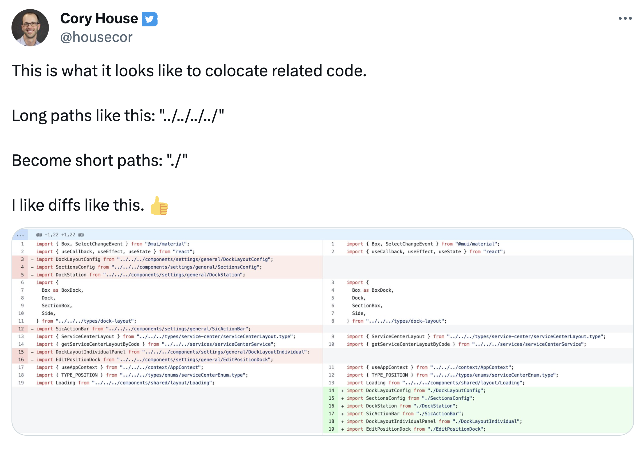
Principle 4
Colocate related code.

Slide 22
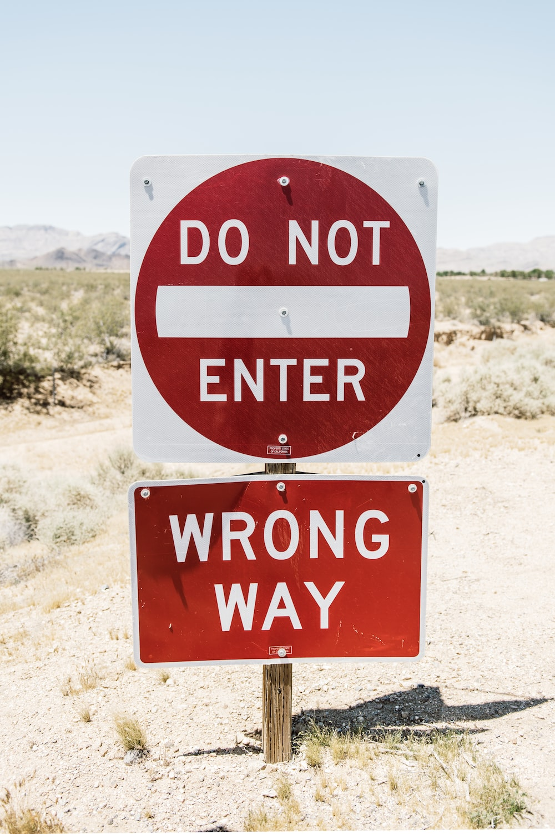
Principle 5
Mark legacy code
Problem: People copy/call legacy code
Solution: Deprecate
Centralize in “legacy”
Check via linter

Slide 23

Principle 6
Make one person responsible for quality
Problem:
Devs feel rushed.
They cut corners.
They often think local and short-term.
Solution: Make one person responsible for quality.
Assure they’re given time to review/pair.
You get what you accept.

Slide 24
Principle 7
Run code in reviews
Problem:
Just reading code in reviews isn’t sufficient.
Solution: Pair. Run the code.
Foster a culture of quality.
Auto-deploy feature branches.
Consider “real-time” collaborative reviews.

Slide 25

Principle 8
Validate at runtime.
Problem: What if the API returns unexpected JSON?
Solution: Zod.

Slide 26
Principle 8
Validate at runtime.
Problem: What if the URL is malformed?
Solution: Zod.

Slide 27
Principle 8
Validate at runtime.
Problem: What if localStorage is malformed?
Solution: Zod.

Slide 28
Principle 8
Validate at runtime.
Problem: What if the file we’re reading is malformed?
Solution: Zod.

Slide 29

Principle 9
Fewer environments is better.
Smells:
Unique env names
Manual syncing between environments

Slide 30

Principle 10
Align repos with the goal.
Here’s how:
Unify repos for single UX.
Eliminate silos.
Collaborate toward a common goal.

Slide 31

Principle 11
Streamline DX and tests via mocks.
How:
Consider mock service worker.
Consider making custom dev tools.

Slide 32

Principle 12
Collaborate. Truly.
Problem:
UI and backend not collaborating.
Solution:
Daily standup together.
No “throwing code over the wall”. Collaborate.
Consider unifying repos, tech, team.

Slide 33

Principle 13
Monitor errors
Problem: When a user gets an error, do we know? Can we reproduce it?
Solution:
TrackJS, Sentry, LogRocket

Slide 34

Principle 14
Design system required.
Problem: How do we assure a consistent UX? How do we assure our components and are actually reusable?
Solution: Create a design system.

Slide 35
Principle 15
Document your reuse strategy.
Honors design system
Unit tests
Discoverable
Placed in shared location
Documented in Storybook
Document props via JSDoc

Slide 36
The End
E2E Tests for every page
Unit tests and stories for reusable components
Only 300 ‘any’
Streamlined data fetching via custom hooks
Caching via React Query
Response validation via Zod
CI that runs build, tests, lint, cspell, knip, Storybook, msw
Error handling via react-error-boundary, React Query TrackJS

Slide 37
Summary

Slide 38
Principles for Rescuing a Failing Project
Worth checking? Worth automating.
Can’t automate. Checklist.
Document decisions in collocated docs.
Document your reuse strategy.
Mark / centralize legacy code.
Make one person responsible for quality.
Run code in reviews.
Validate at runtime.

Slide 39
Principles for Rescuing a Failing Project
Minimize the number of environments.
Align repos with the goal.
Streamline DX and tests via mocks.
Collaborate across teams or unify.
Monitor errors.
Create a design system and use it.
Document your code reuse strategy.

Slide 40
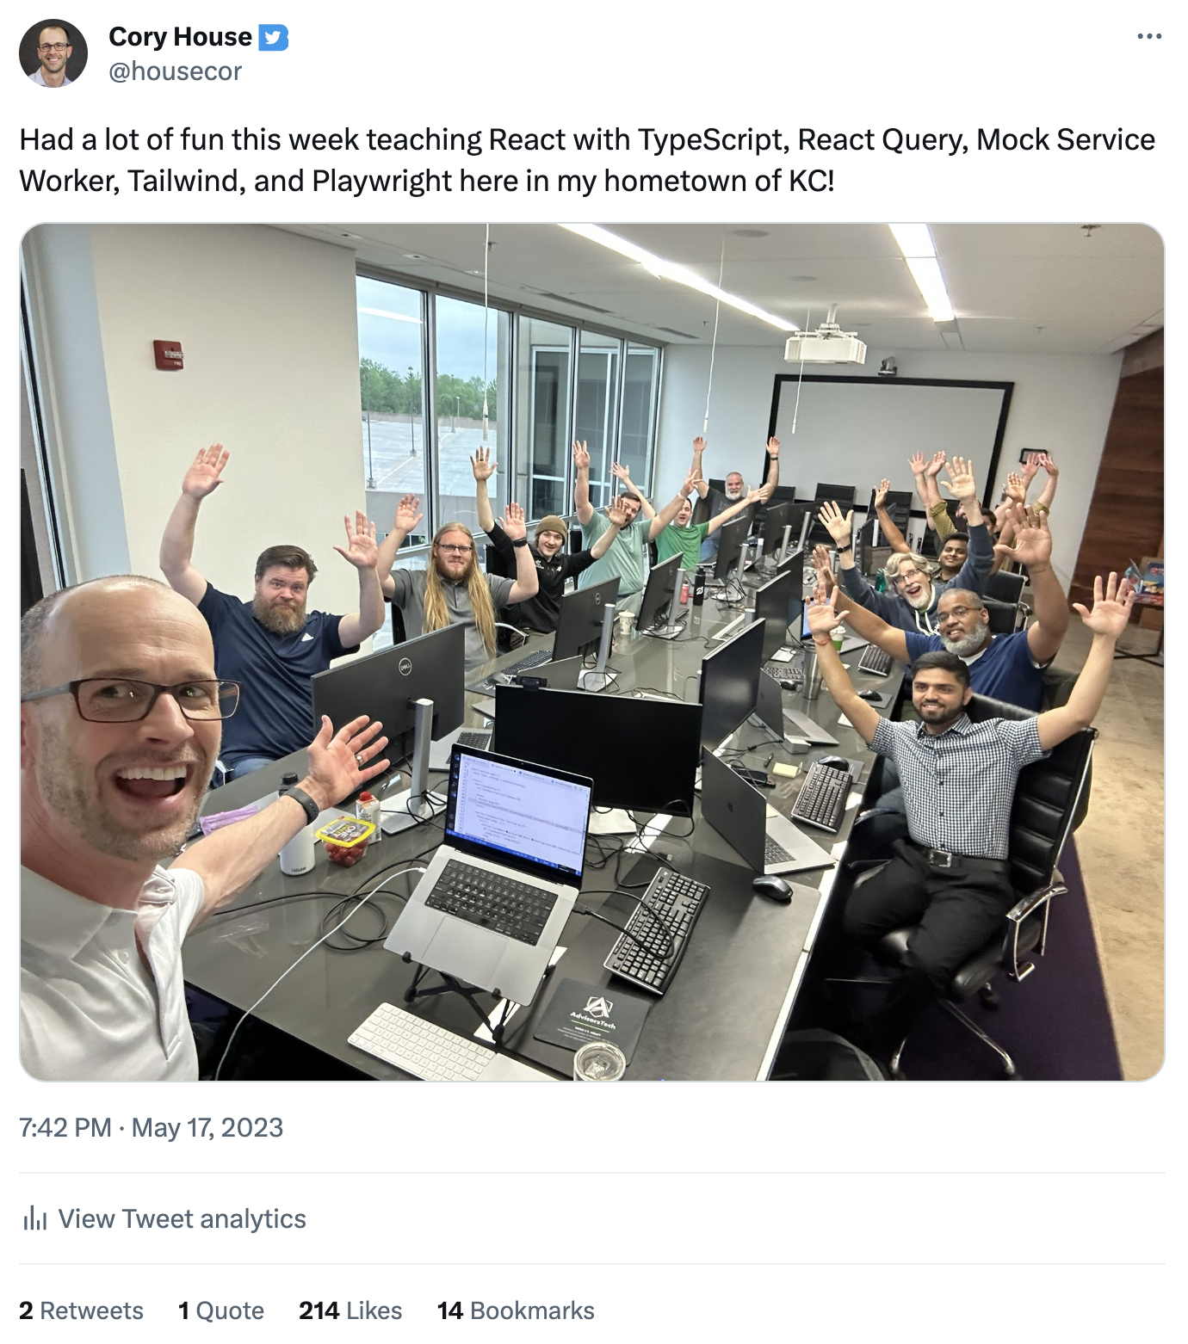
reactjsconsulting.com

Slide 41

reactjsconsulting.com

Slide 42

Slides
bit.ly/rescue-project-codemash

Slide 43

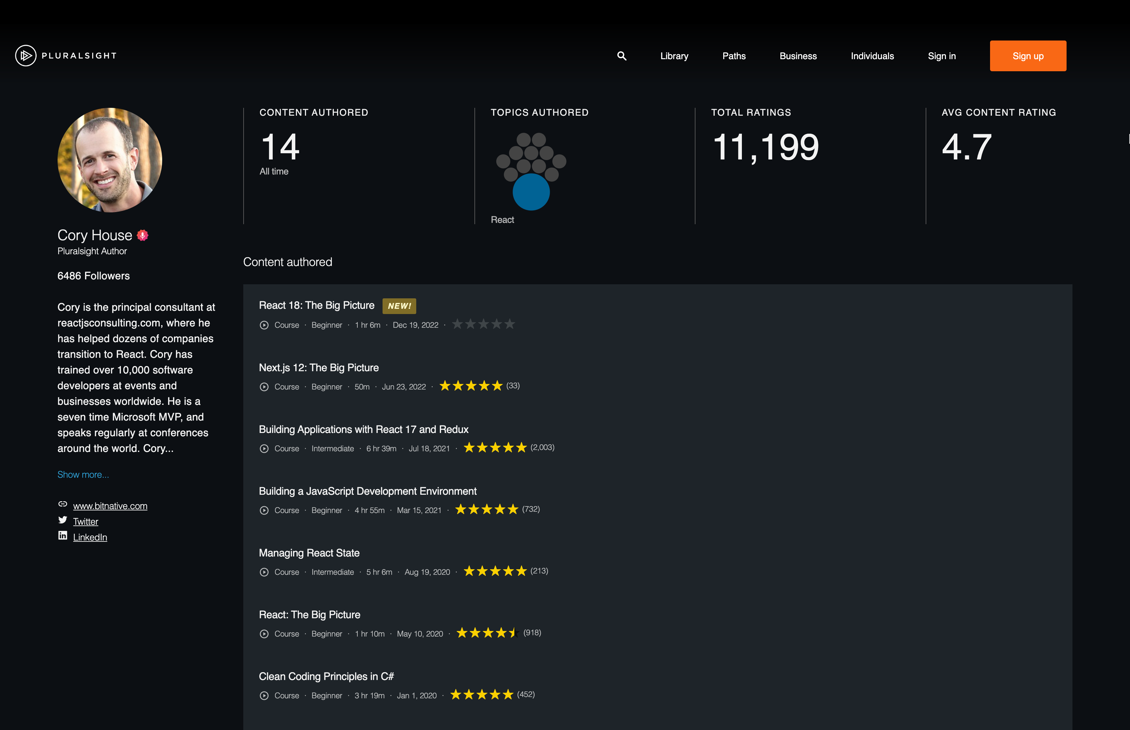
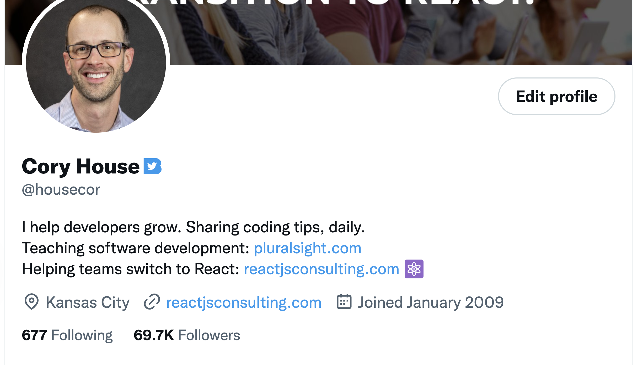
reactjsconsulting.com
Consulting and training
pluralsight.com
Software courses
@housecor
Twitter

